Slide 1


Advisor : Hoon Sung Chwa
Weekly Meeting
2023.04.06
Dept of Information & Communication Engineering, DGIST
Real-Time Computing Lab
Kang Young Eun ( kye0520 @dgist.ac.kr)

Slide 2
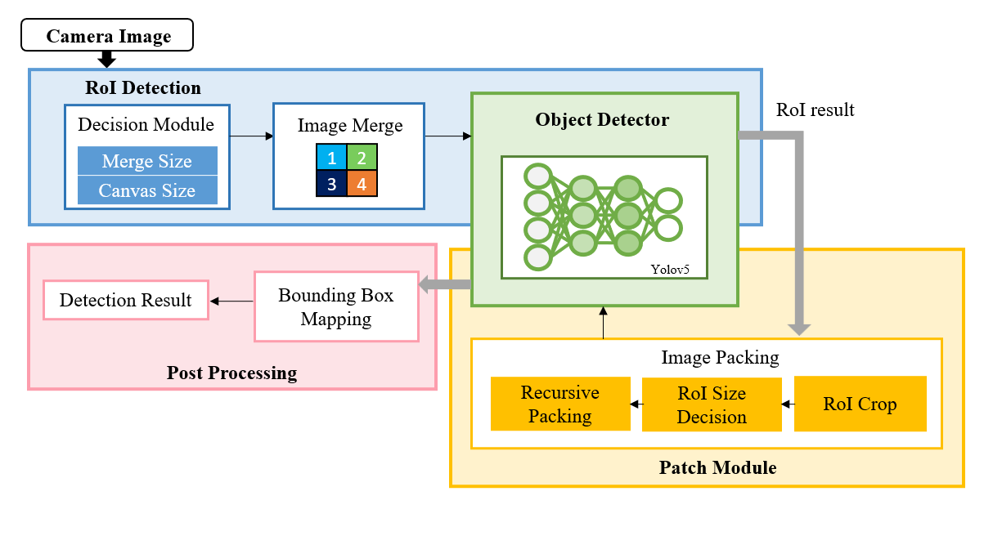
Content
Control Knob Selection Mechanism
Decision Module
Roi Size Decision
2

Slide 3
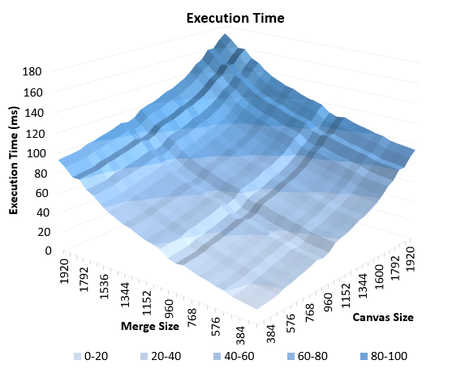
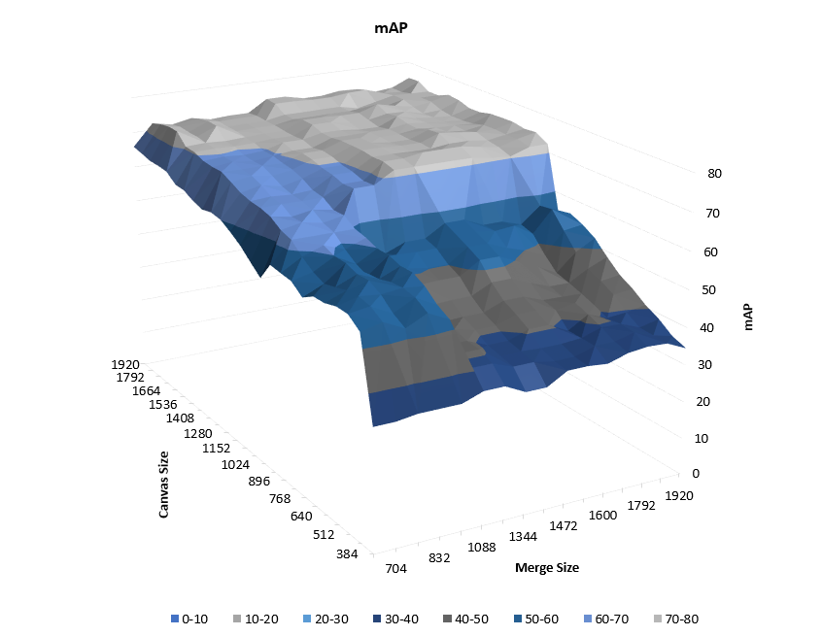
Merge and Canvas Size
Decision Mechanism
Camera Image
Decision Module
Deadline
Accuracy
Deadline
Merge Size
Canvas Size
Combination with highest accuracy
Image Merge
Set of size combination
1
2
3
4
3
Notes:
Deadline, canvas&object size set, highest accuracy considering number of objects in a frame

Slide 4
Merge and Canvas Size
Execution time of different Merge and Canvas size
4
Notes:
별 특이 사항은 없고 execution time에 있어서는 작은 것 merge 하면 작고 큰거끼리 merge 하면 커지는 그런 그래프

Slide 5
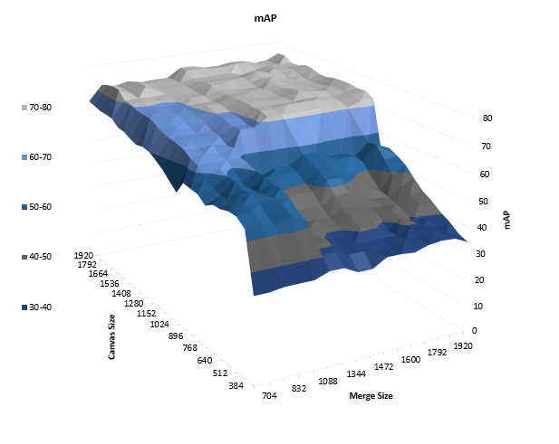
Merge and Canvas Size
Accuracy of different Merge and Canvas size
Minimize Merge size : Accuracy is not sensitive to merge size.
Maximize Canvas Size : Larger canvas size results in higher detection accuracy.
5
Notes:
Canvas size는 키우고 merge size는 적당한 사이즈로 측정하도록 선택
Detection 이미지 중에서 큰 object가 많은 이미지의 비중이 많기 때문.

Slide 6
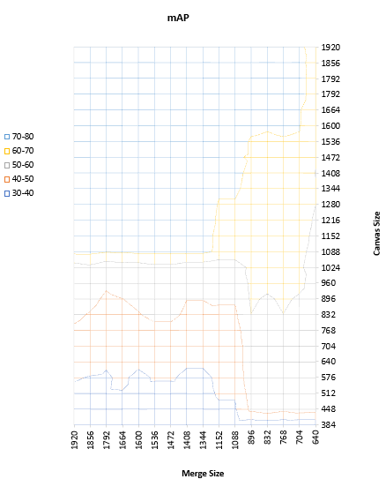
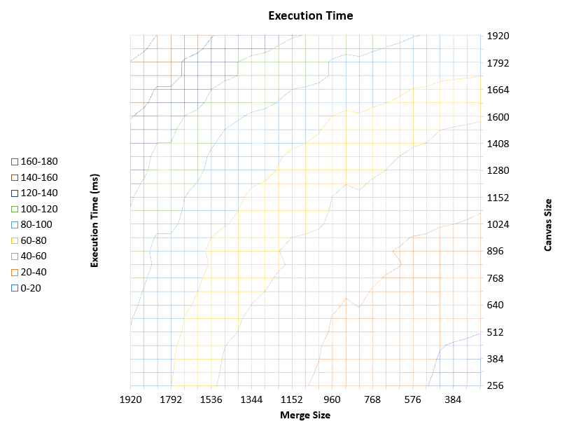
Merge and Canvas Size
Feasibility sample case
Vanilla Yolo 172ms with 77.3 mAP
Patching 172ms 75.3 mAP
2 mAP loss can be compensated with object scaling.
6
Notes:
실제로 더 높더라느

Slide 7
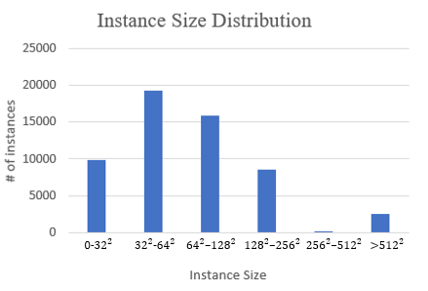
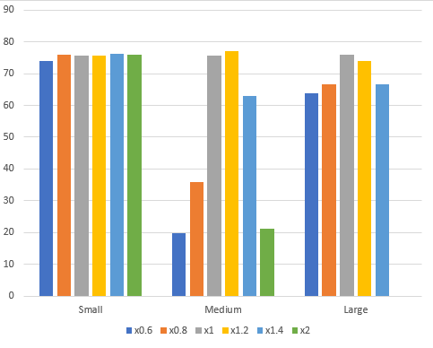
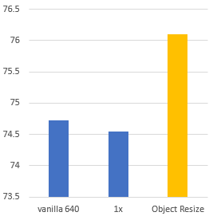
Object Size Selection
Experiment Setup
Object size Small Medium Large
Object resized in x0.6, x0.8, x1, x1.2, x1.4, x2
Accuracy results of resized objects
Accuracy results comparison
1.4
1.2
1
7

Slide 8
To Do
Object Size Applied Accuracy
Feasibility Testing
8
Notes:
Canvas에 들어가는 size 내에서 가장 정확도 높일 수 있는 optimal 한 object size 찾고 그렇게 object size를 적용했을 때의 정확도 구하기.

Slide 9

Advisor : Hoon Sung Chwa
Thank you
Dept of Information & Communication Engineering, DGIST
Real-Time Computing Lab
Kang Young Eun (kye0520@dgist.ac.kr)

